Slide 1

Can we predict churn decision of our customers?
Ezgi Nazman
An international customer churn bank data

Slide 2

Churn factors?
Credit Score?
Country?
Gender?
Age group?
Tenure?
Balance?
Number of products?
Has credit card?
Is active member?
Estimated Salary?

Slide 3
Methodology
Feature Engineering
Comparison of Machine Learning Methods
Flask and Heroku WebApp

Slide 4
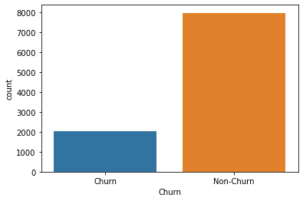
Group Label

Slide 5
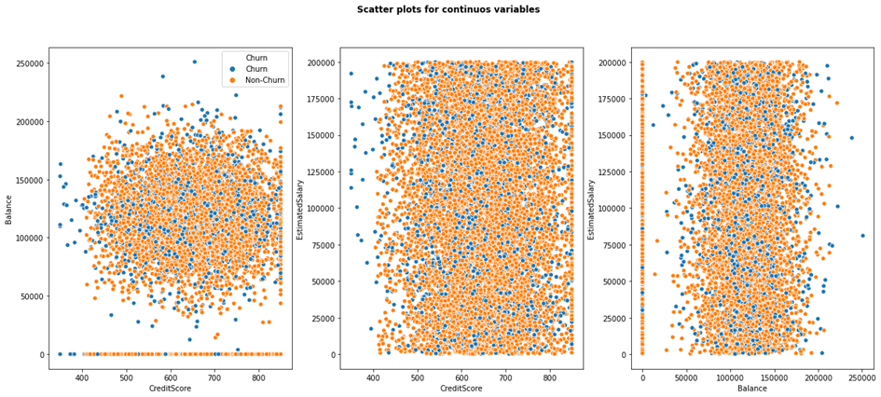
Which algorithm should I prefer?

Slide 6
Machine Learning Methods
Binary Logistic Regression
Support Vector Machine
Gradient Boosting
Bagging Decision Tree
Random Forest
Extra Tree
AdaBoost
Stochastic Gradient Boosting
Voting Ensemble
XGBoost

Slide 7
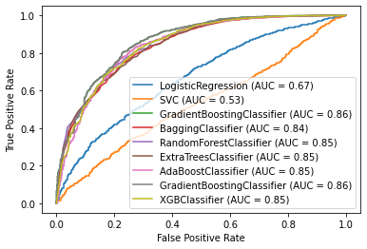
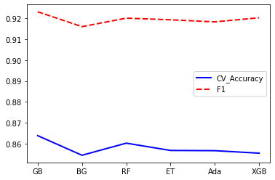
Comparison Results

Slide 8
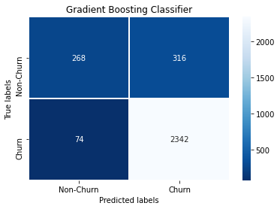
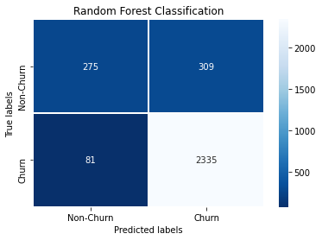
How to choose the best algorithm?

Slide 9
Flask and Heroku WebApp
https://bank-customer-churn.herokuapp.com/

